Slide 1
The Complexity of Urban Information Gathering
Abdulfatai Popoola

Slide 2
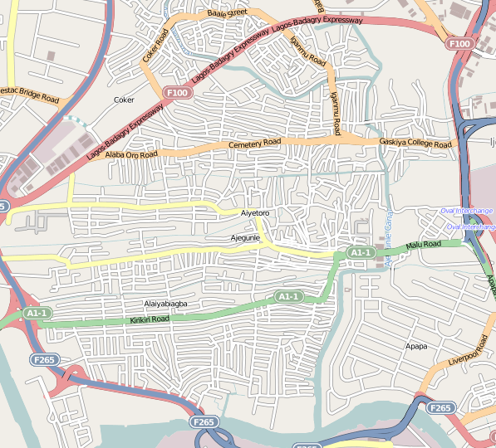

Slide 3
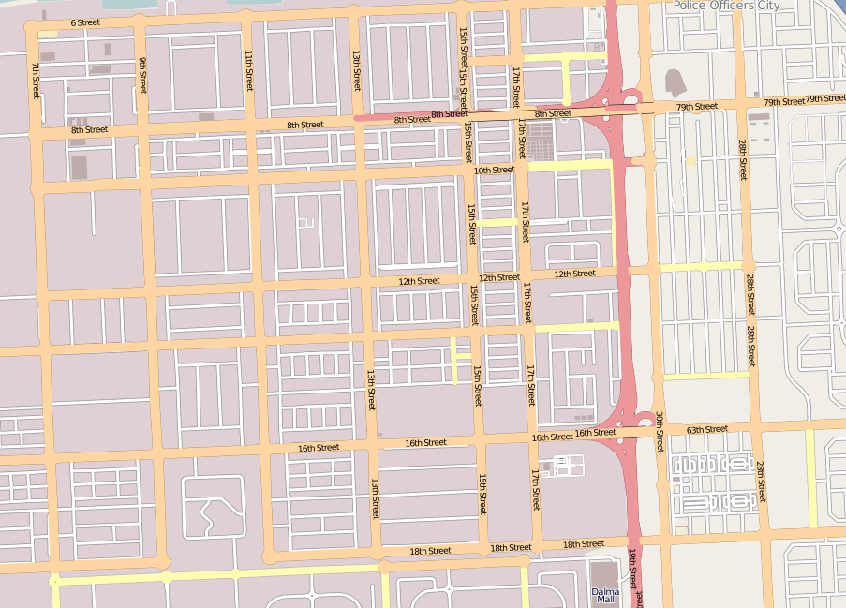

Slide 5
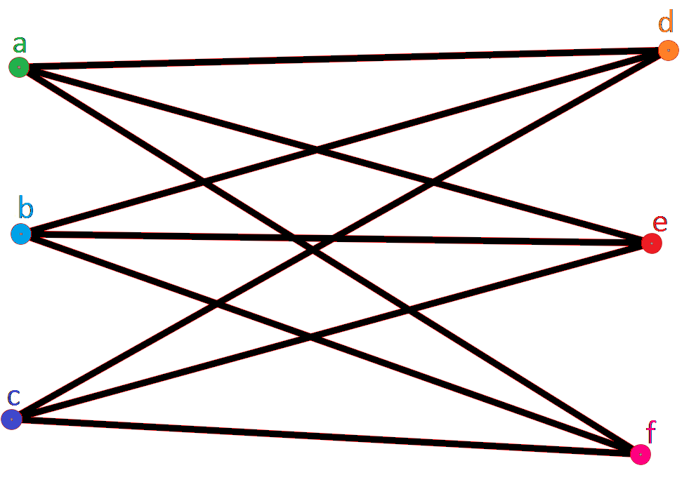
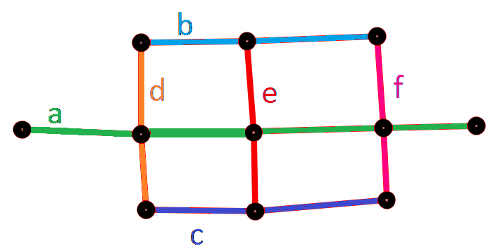
Representation Formats
Primal
Dual

Slide 6
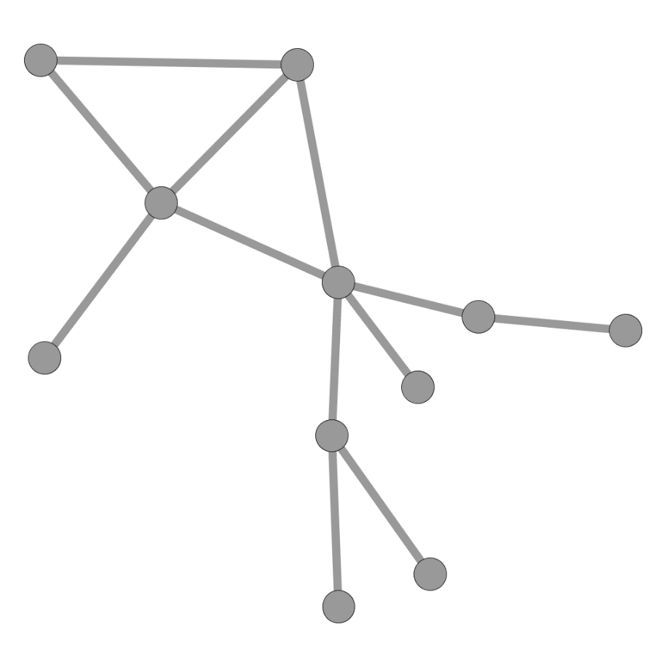

Slide 7
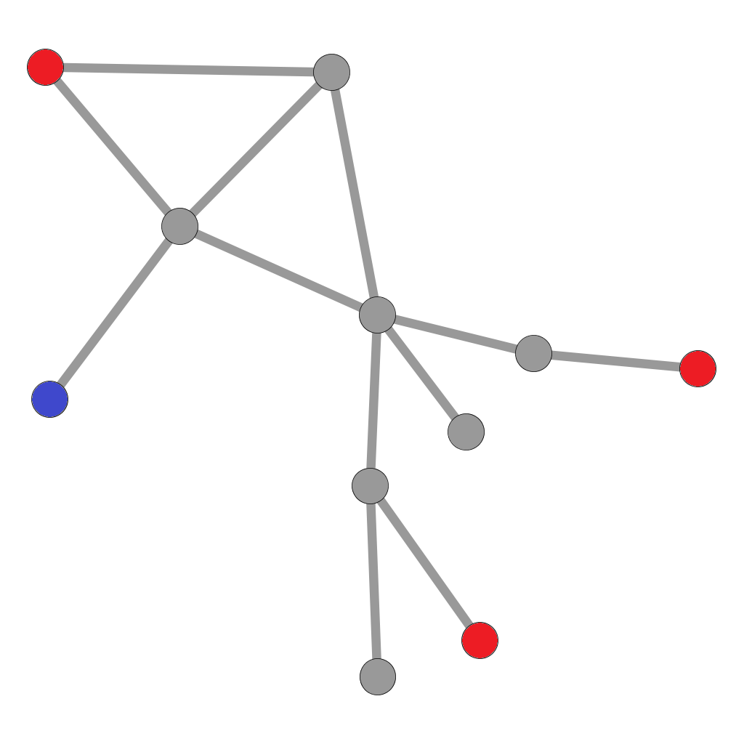

Slide 8
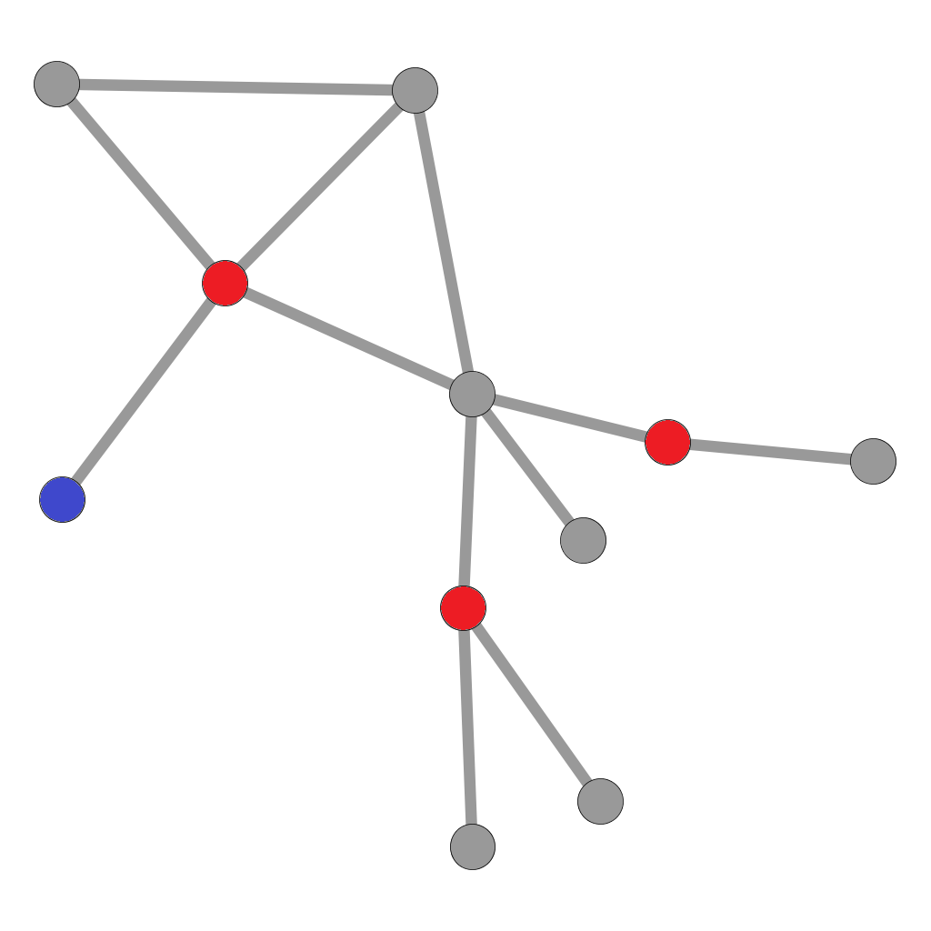

Slide 9


Measuring Difficulty

Slide 10
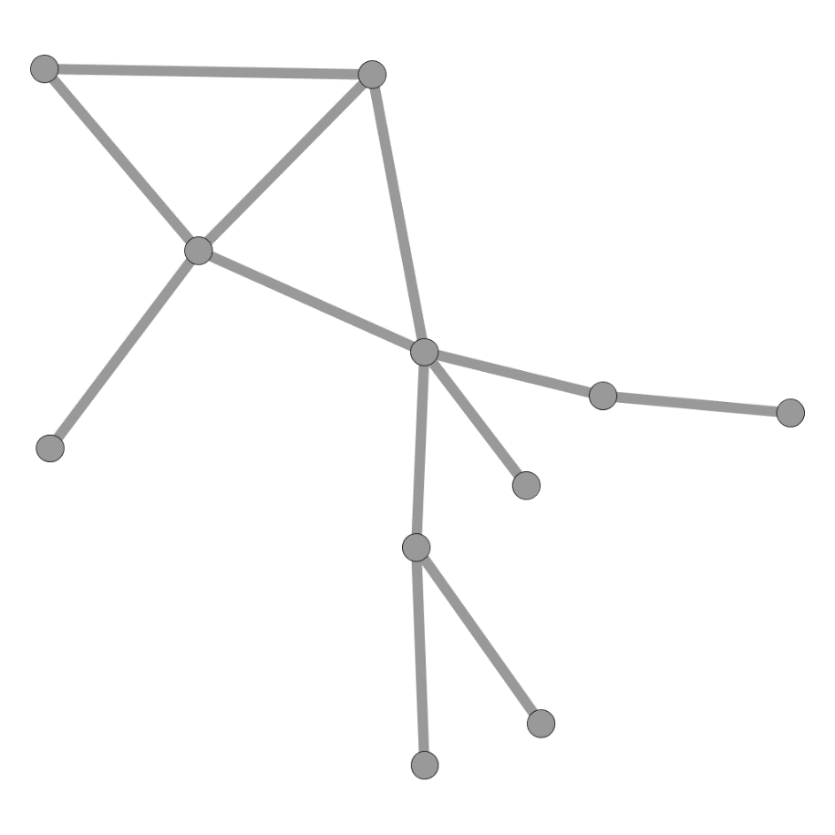
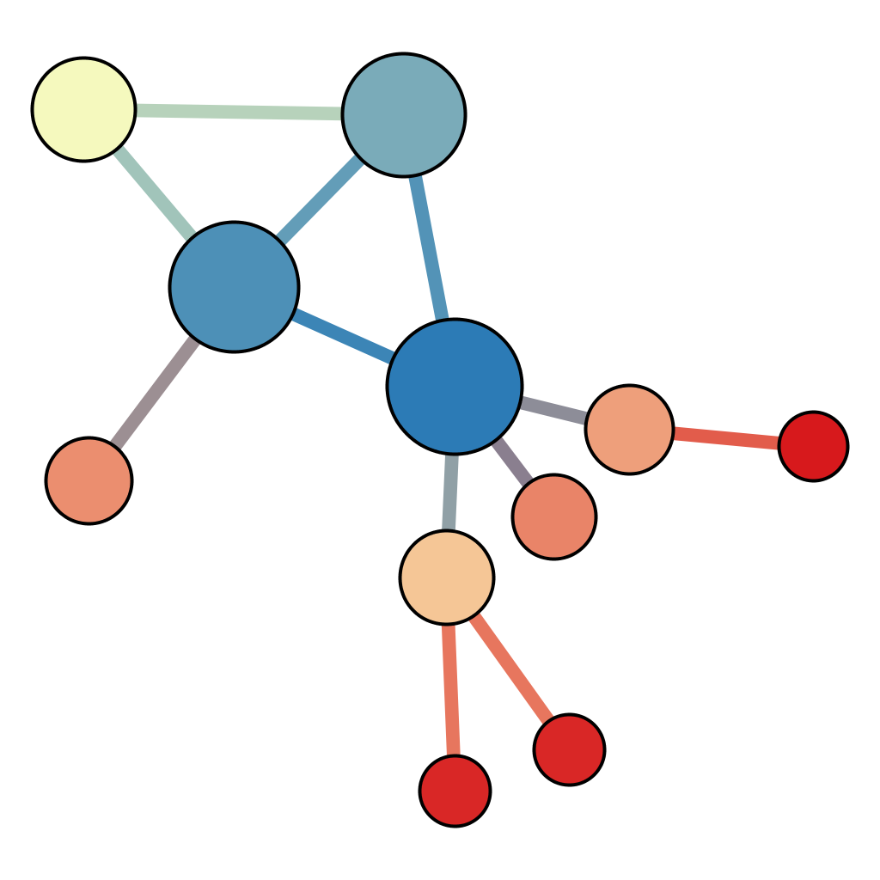
Eigenvector Centrality

Slide 11
Metrics
Centrality Measure | Significance
Entropy | Uncertainty
Gini Coefficient | Diversity
Coefficient of Variation | Variation
Freeman Degree Centralization | Network Structure

Slide 13
Metrics - Significance
Centrality Measure | Significance
Entropy | High values -> ease of search
Gini Coefficient | Low values -> ease of search
Coefficient of Variation | Variation in road popularity
Freeman Degree Centralization | City layout

Slide 14
Overview
Stage I
Data collection
Stage II
Processing
Stage III
Analysis

Slide 15
Stage 1: Data Collection
Openstreetmap
Challenges
Extra data: age, crime, continent, structure, area, population

Slide 16
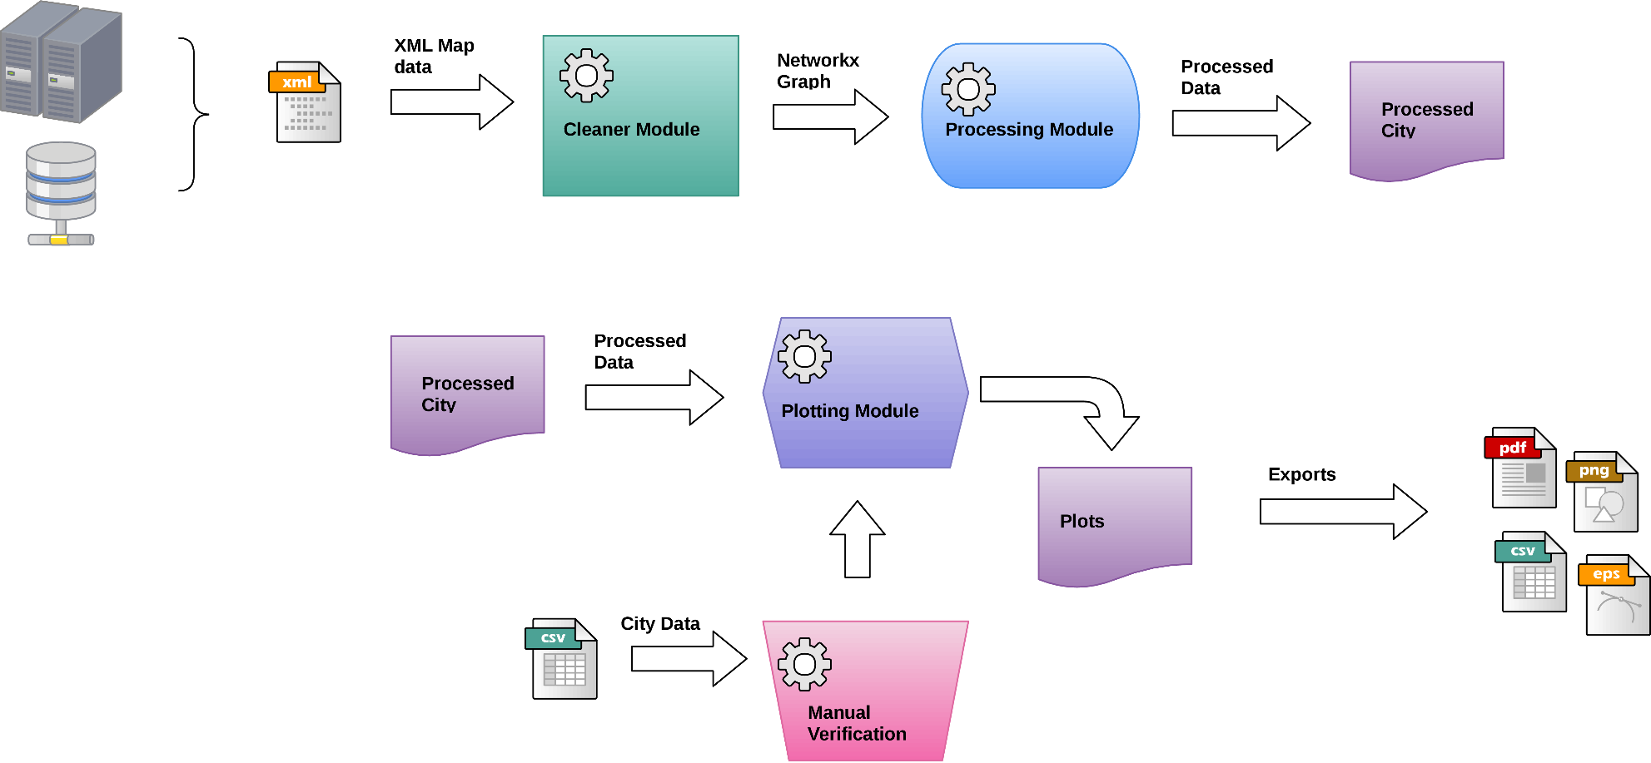

Slide 17
Merging Roads

Slide 18
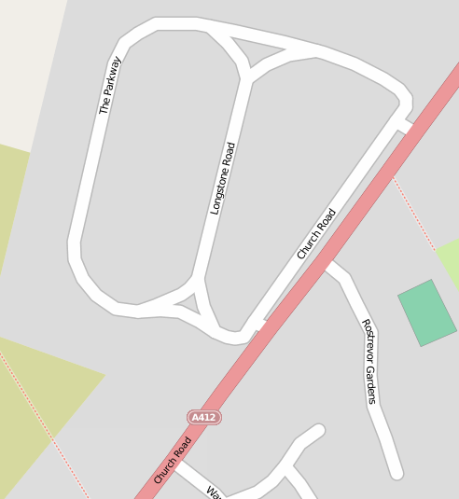

Slide 19
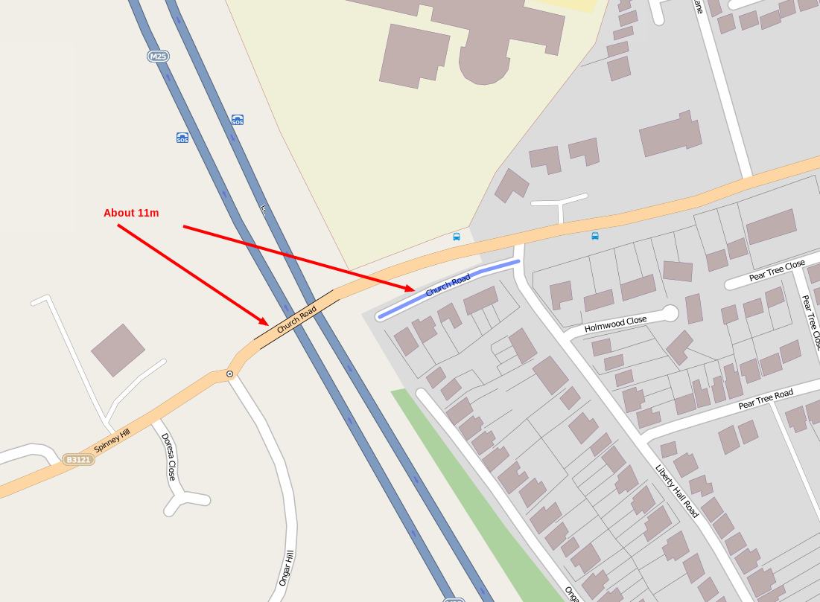

Slide 20
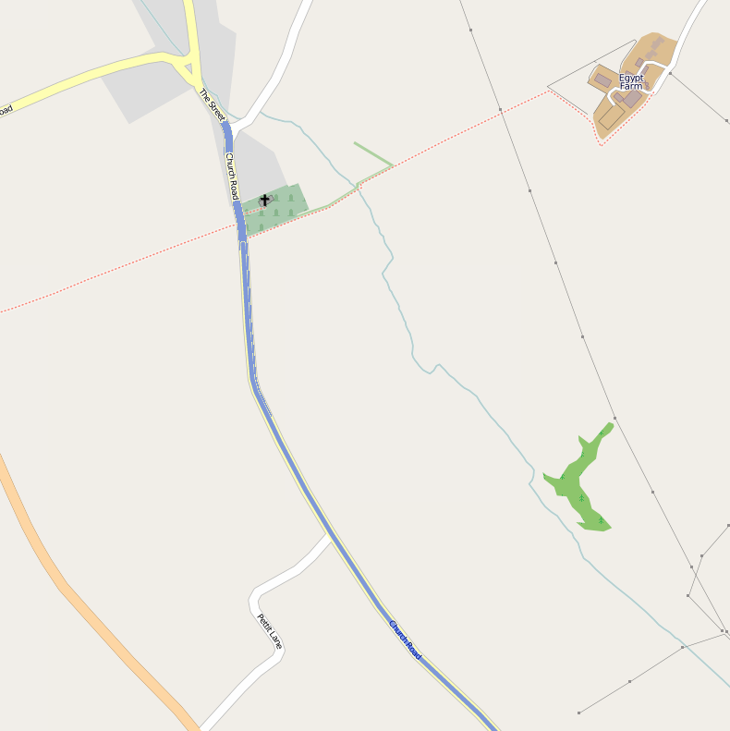

Slide 22
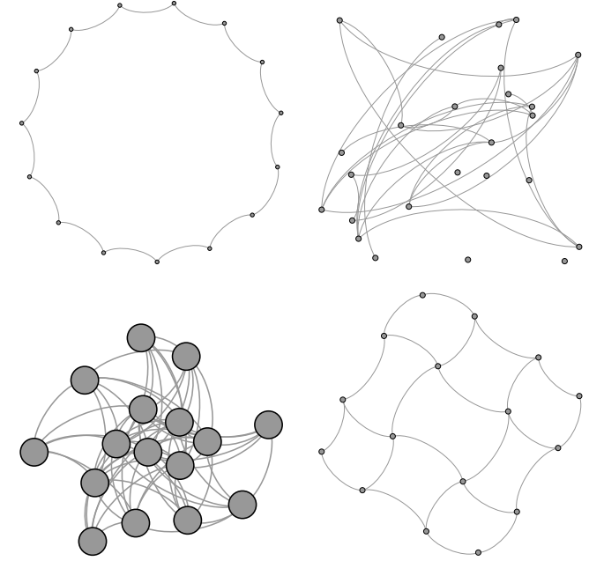

Slide 23
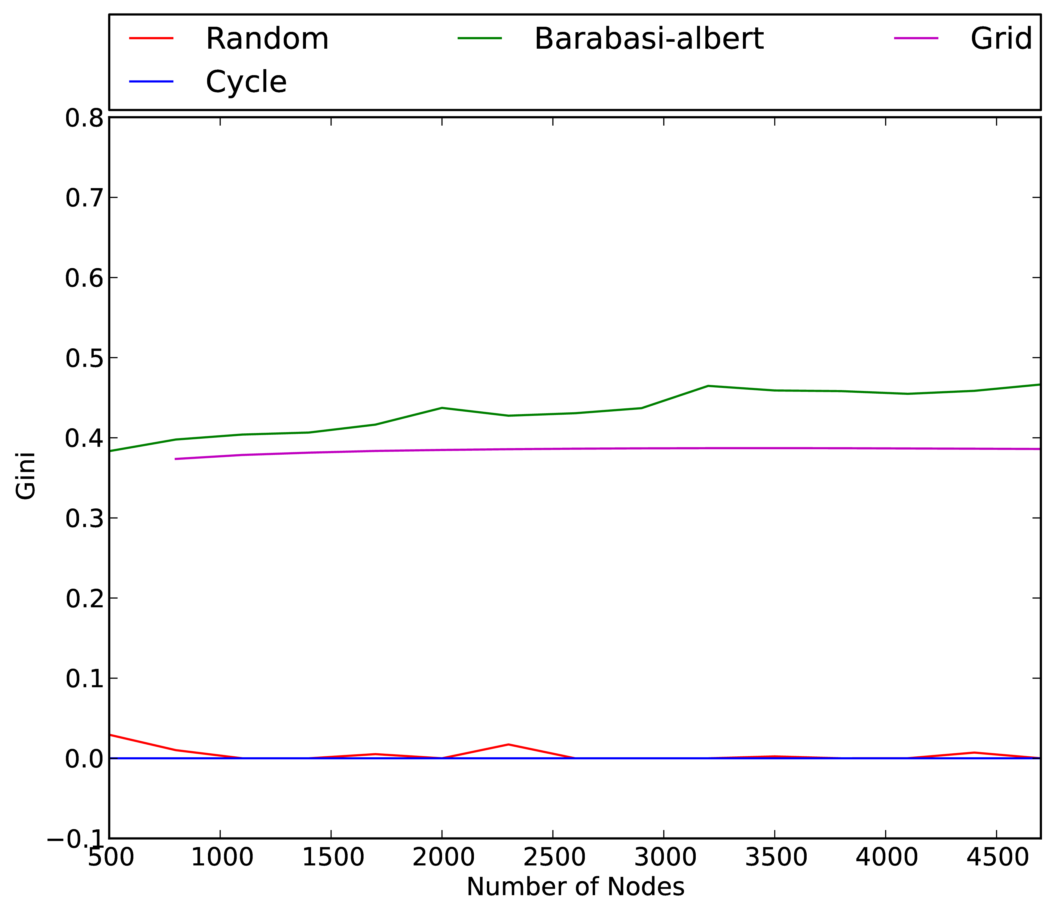
Artificial data

Slide 24
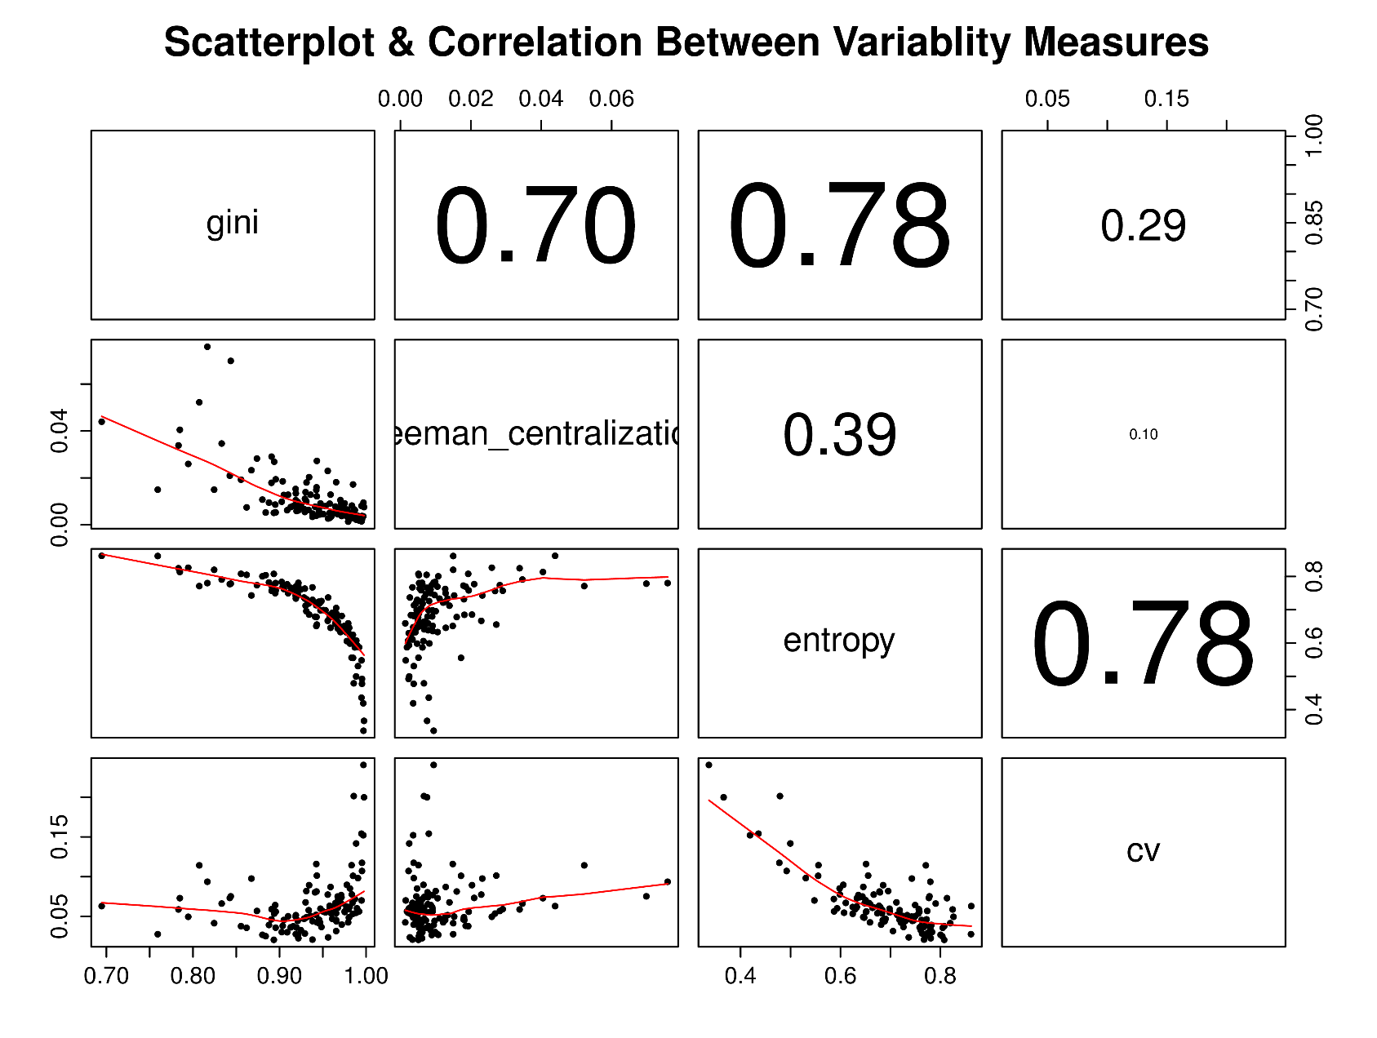
Processed Data
Inter metric correlations

Slide 25
Discoveries…

Slide 26
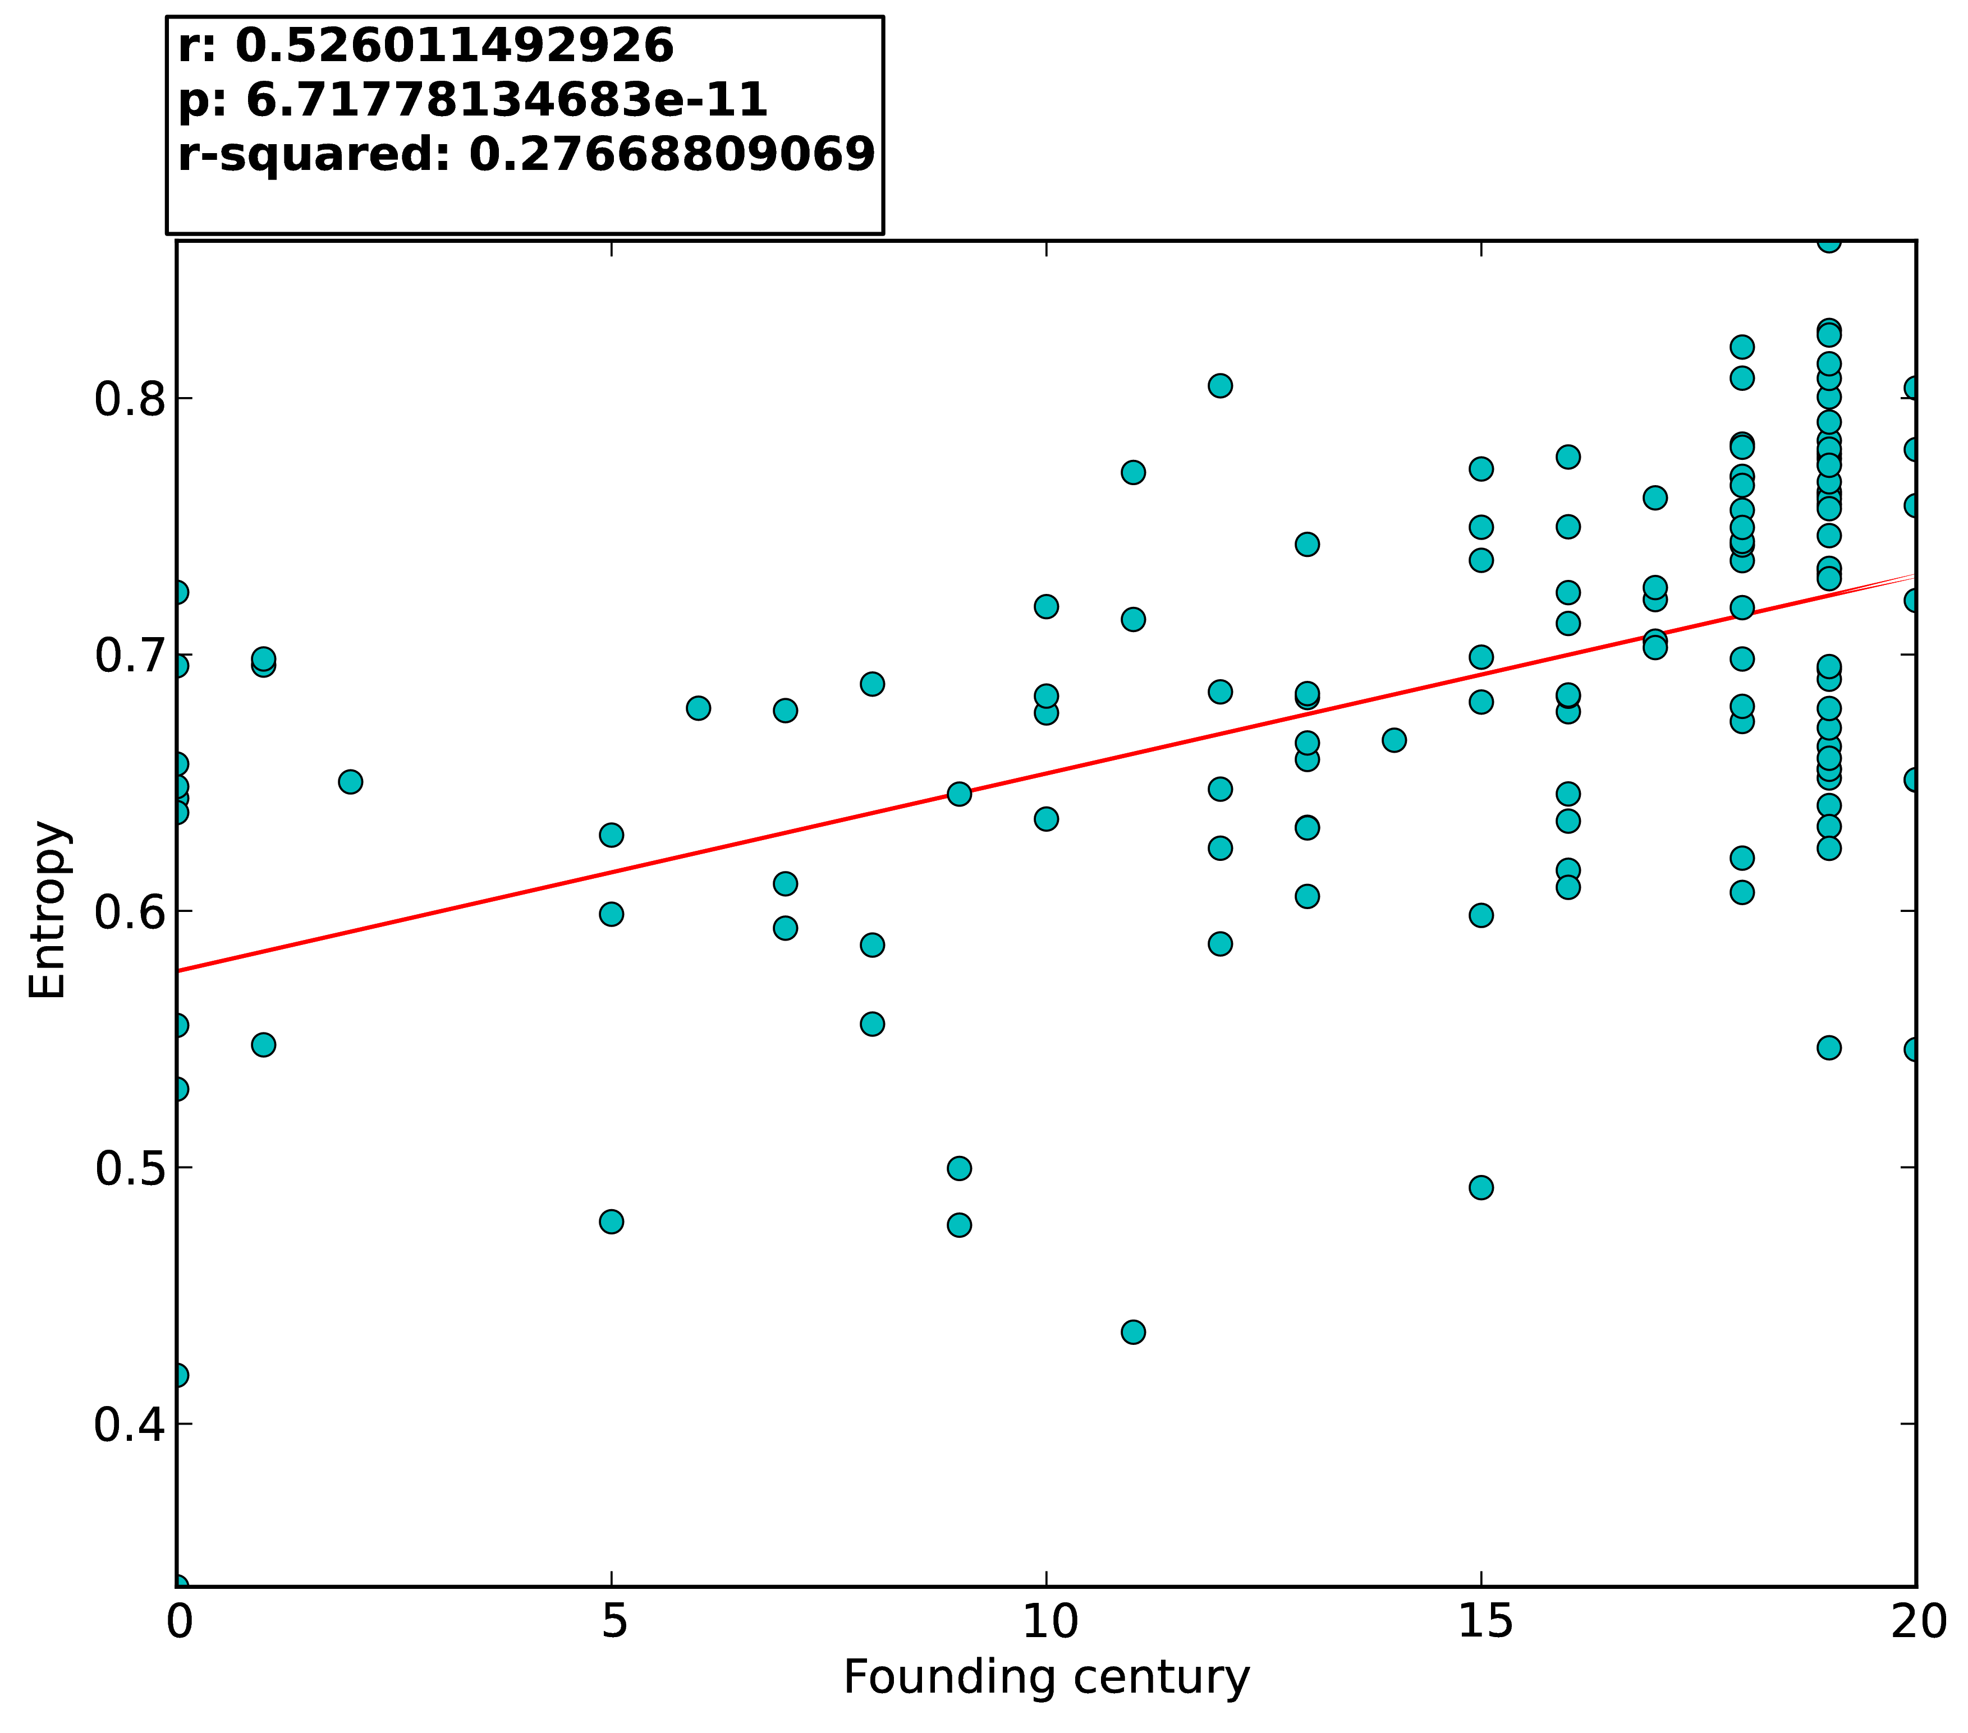
Correlation
Age

Slide 27
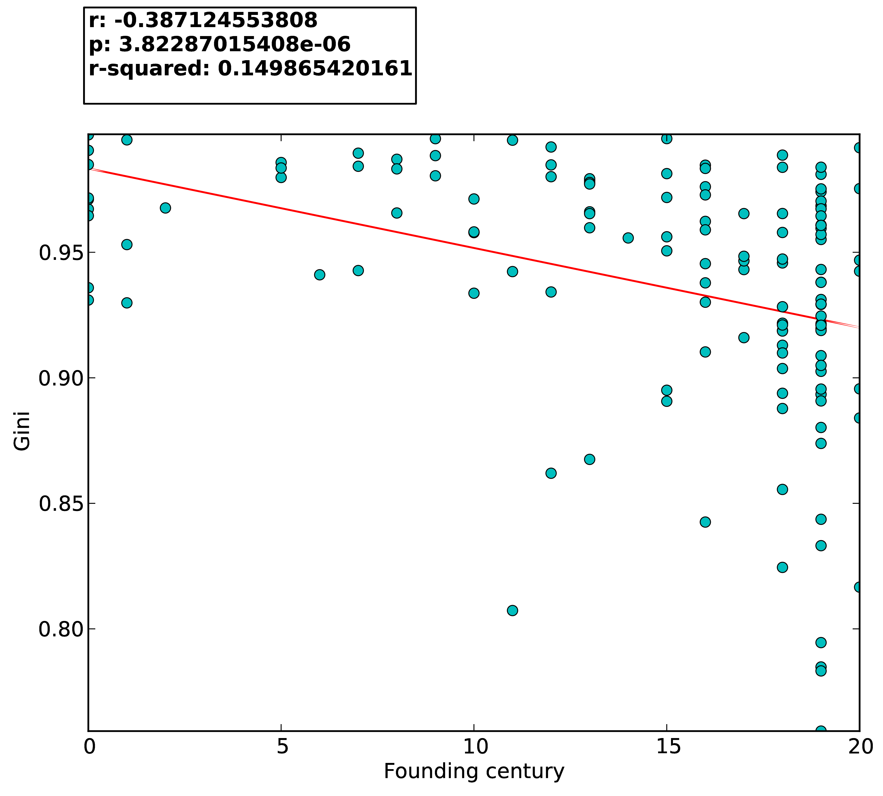
Correlation
Age

Slide 28
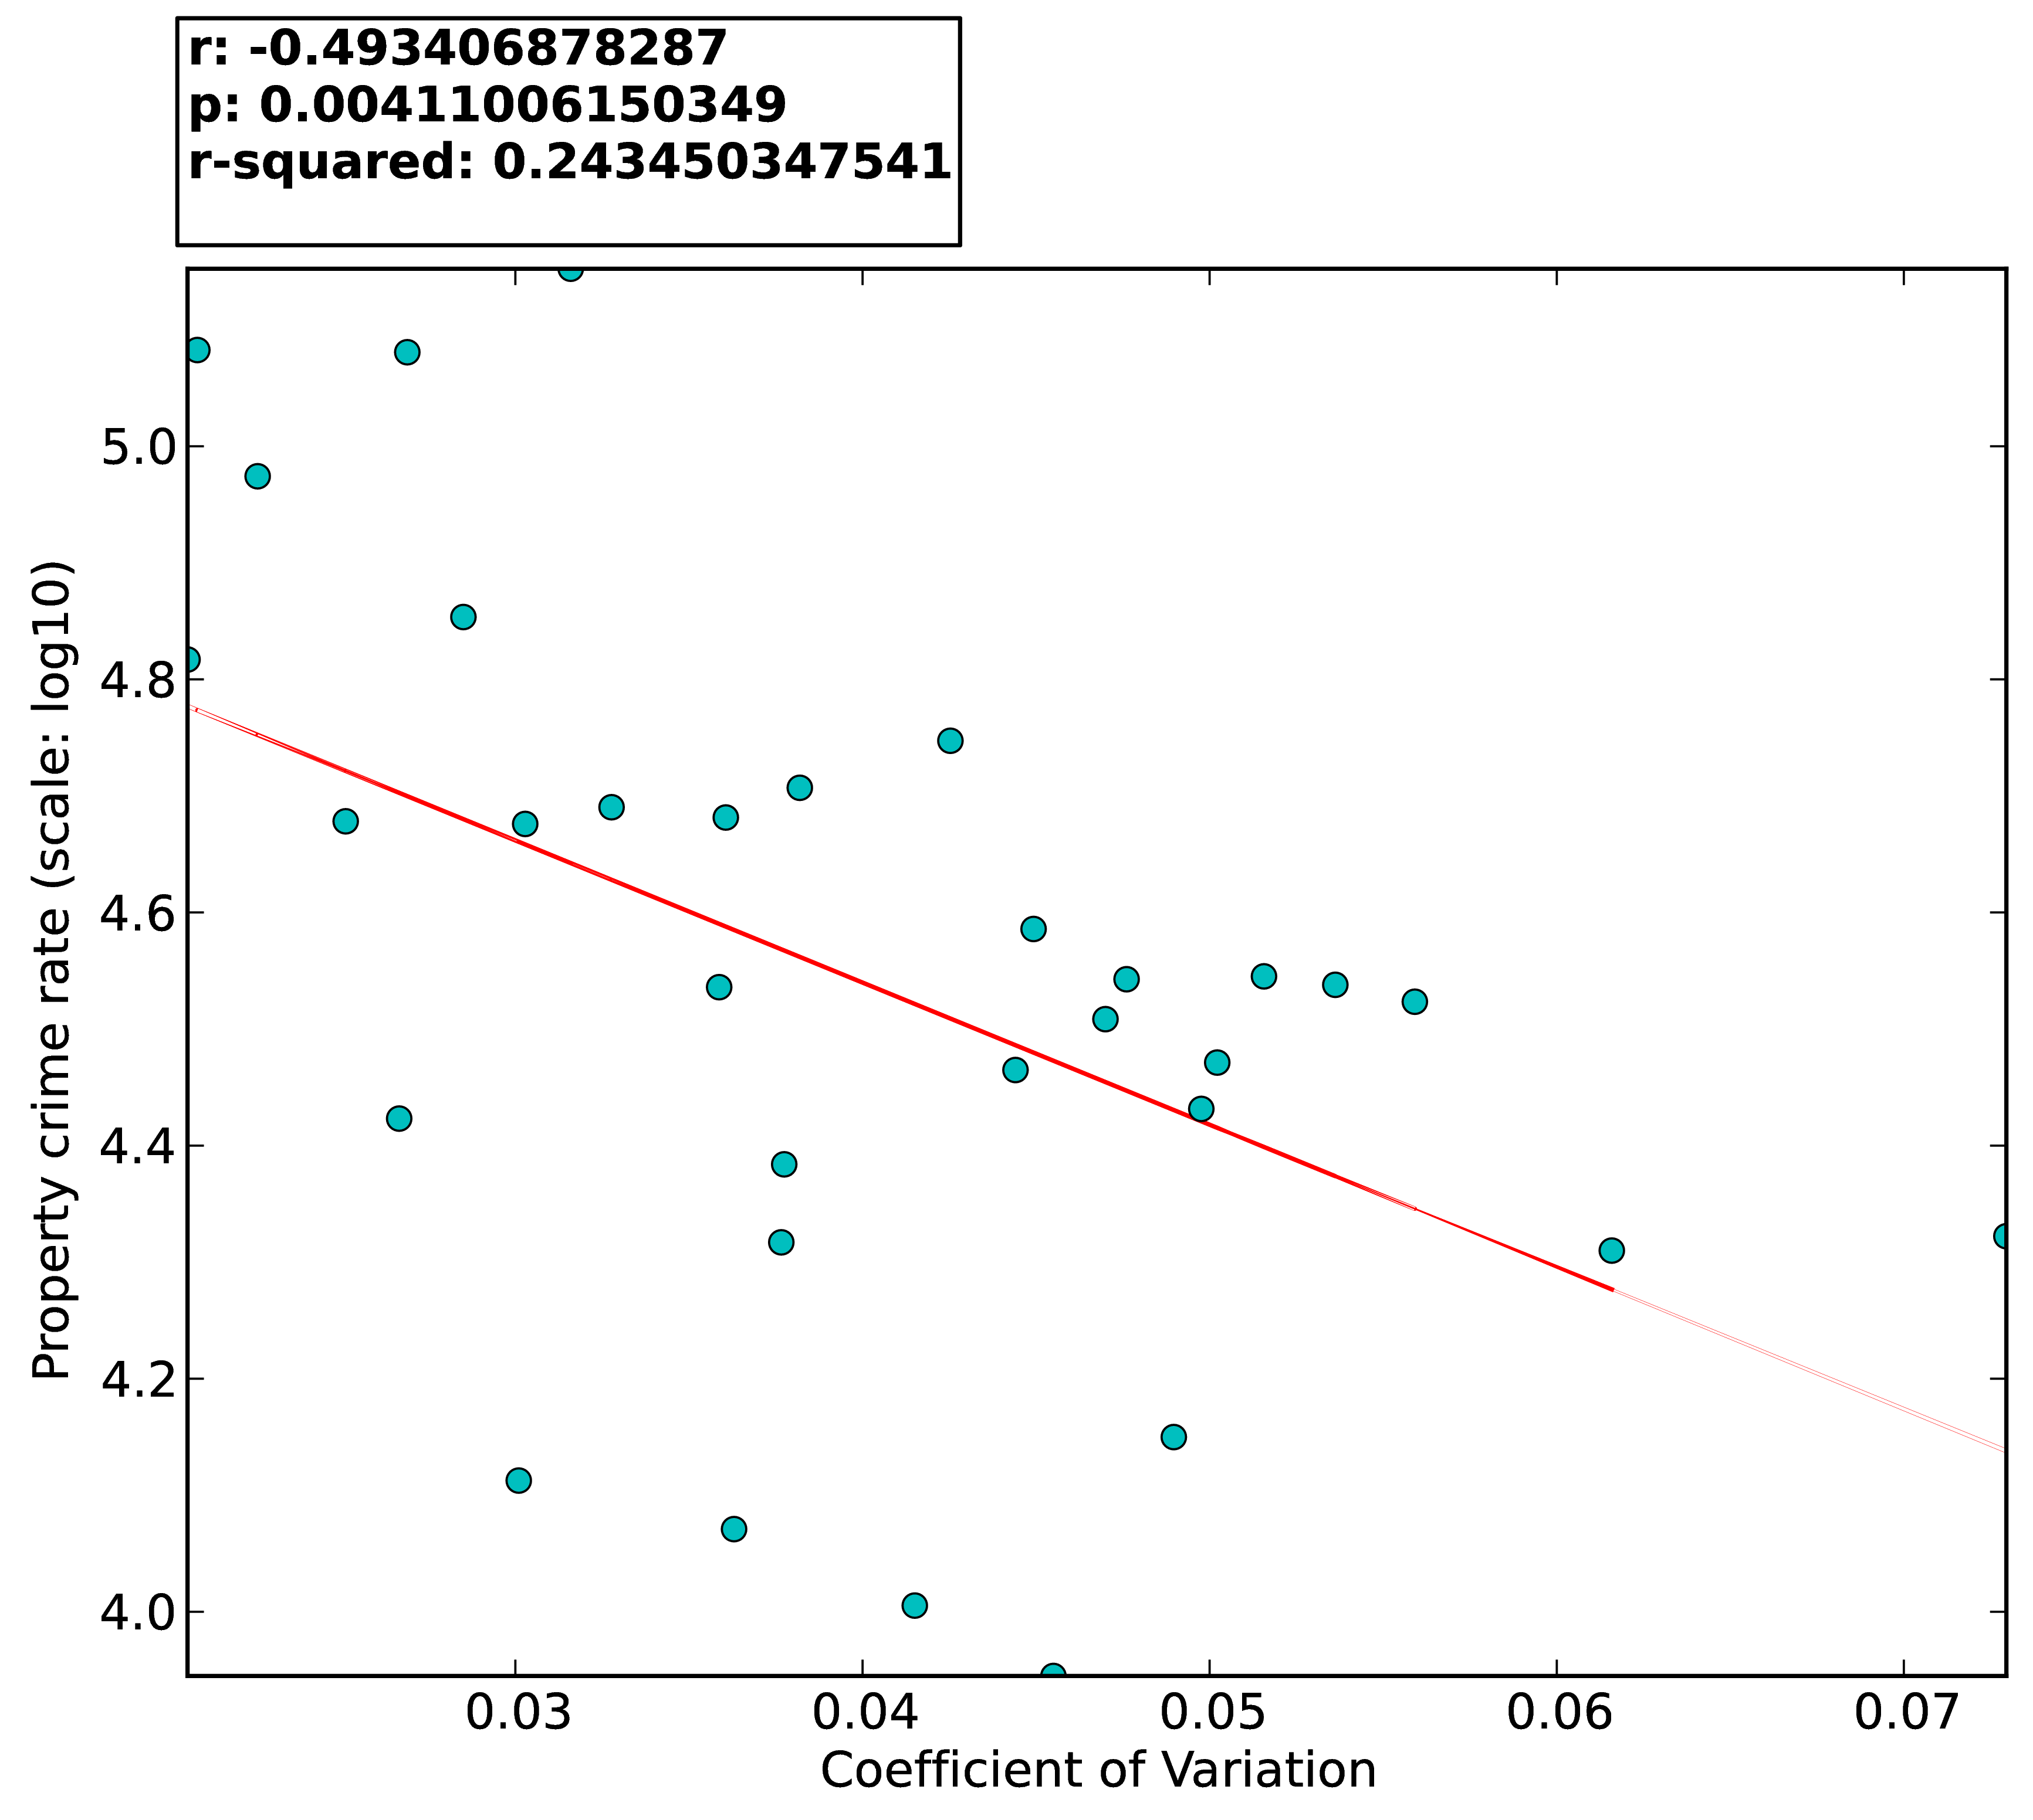
Correlation
Crime I

Slide 29
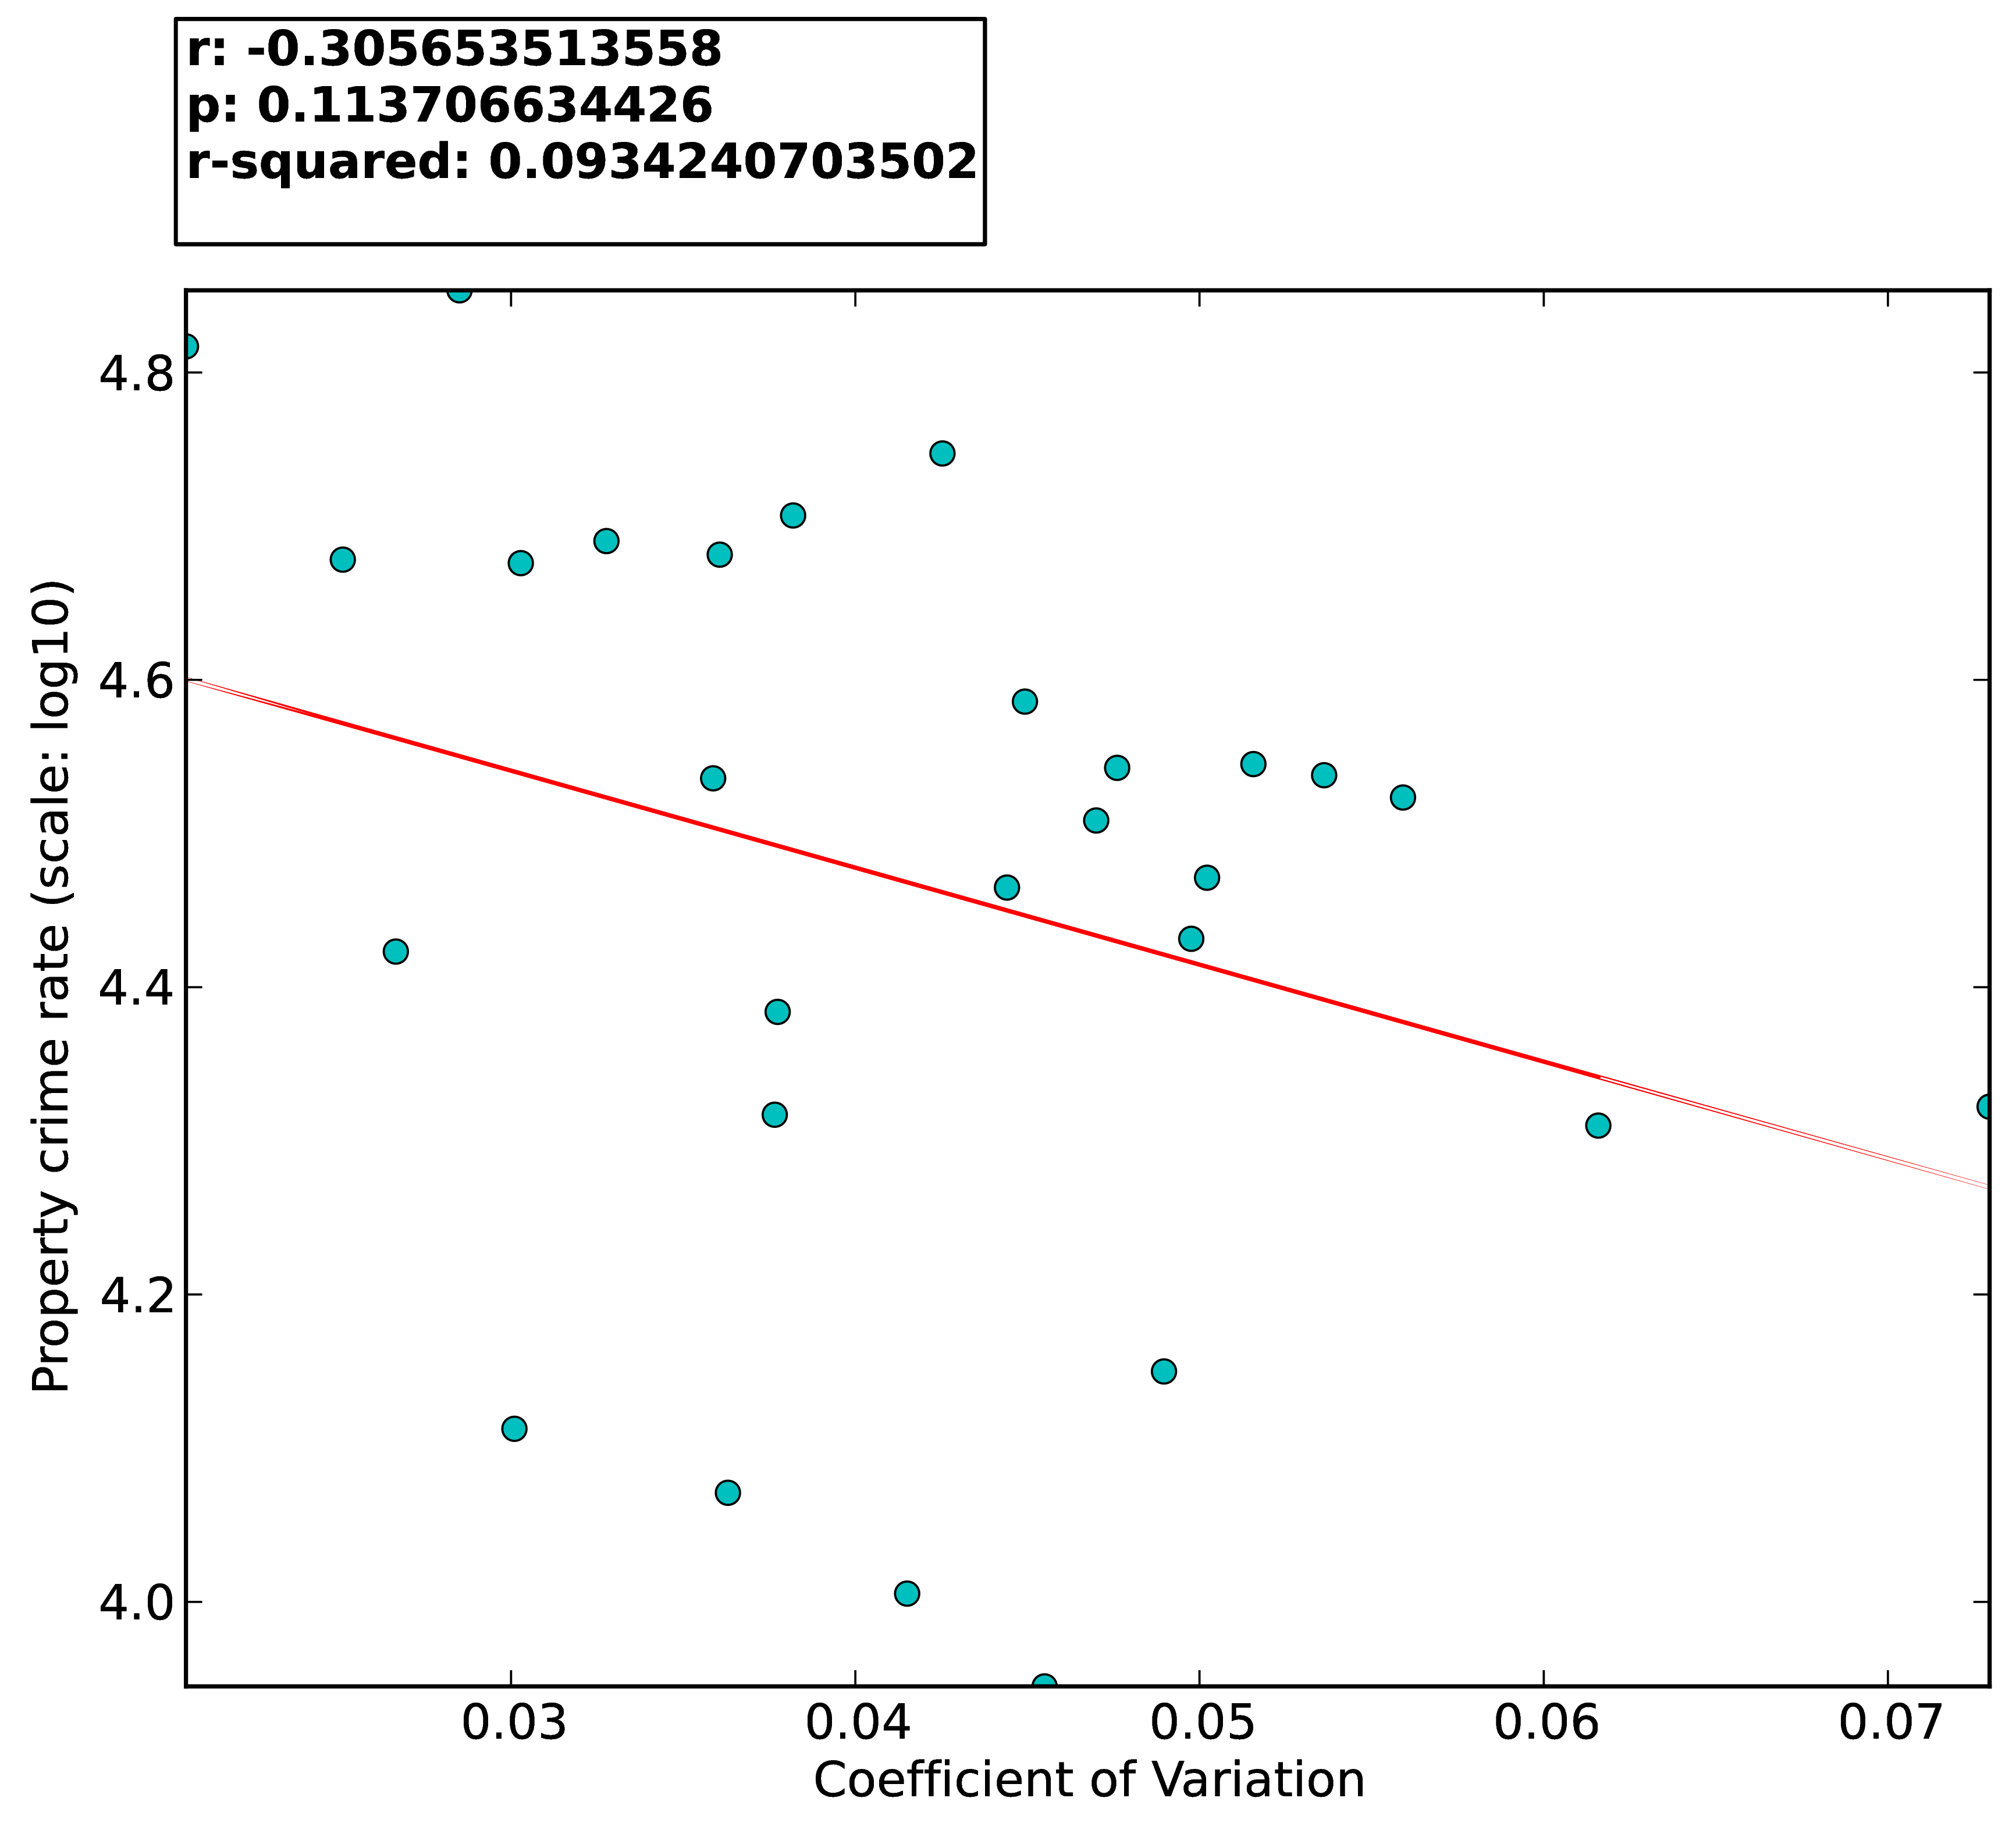
Correlation
Crime II

Slide 30
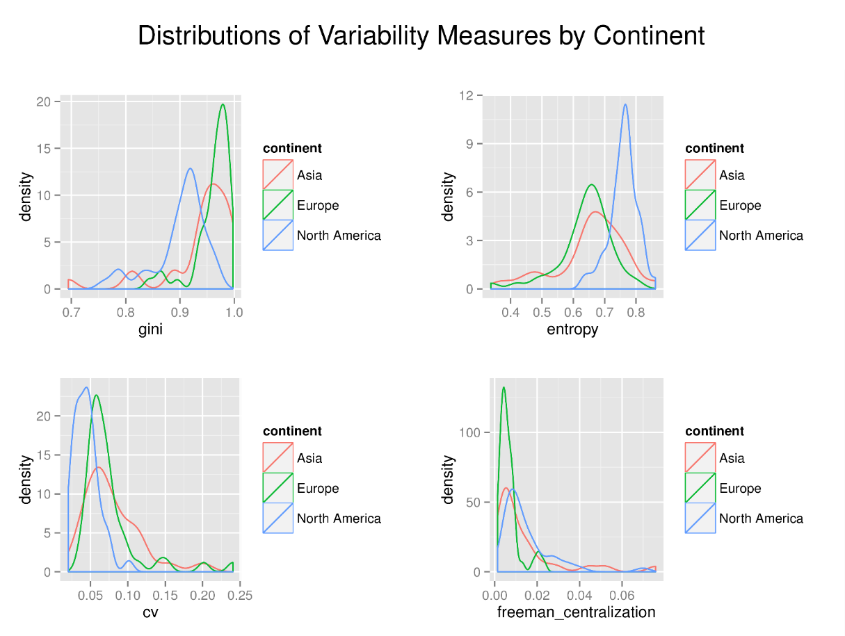

Slide 31
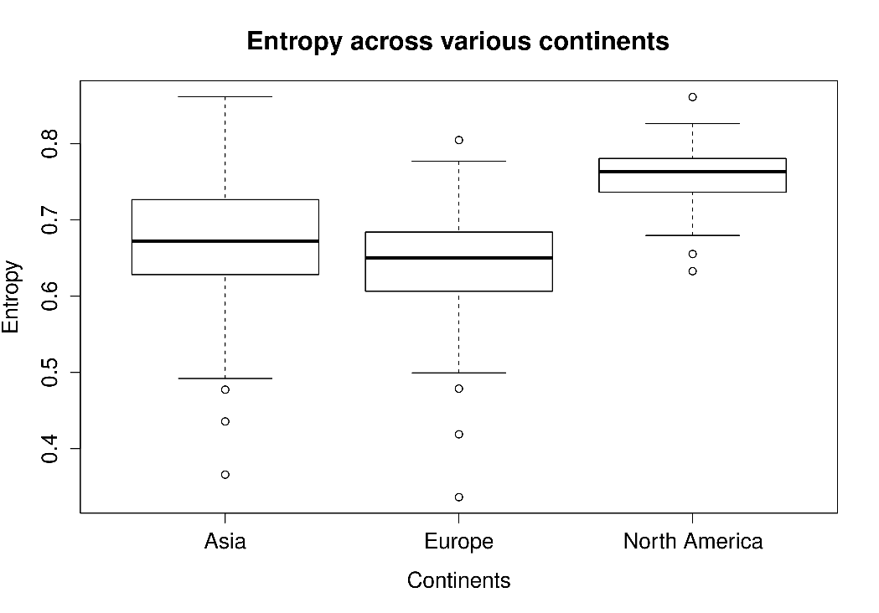
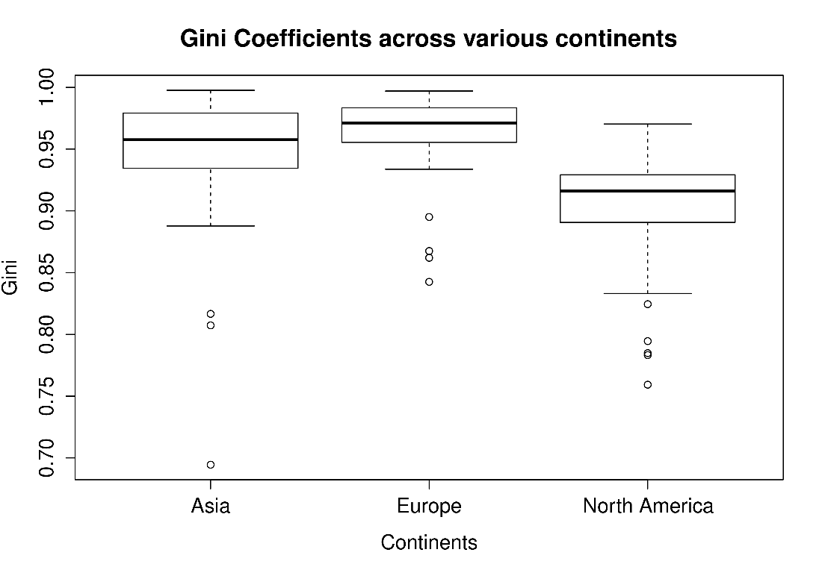
Continental Boxplots
Entropy
Gini Coefficient

Slide 32
Stats
 | df | H | P < 0.05
Entropy | 2 | 51.62 | True
Gini Coefficient | 2 | 44.65 | True
 | Difference
Asia-Europe | False
Asia-North America | True
Europe-North America | True

Slide 33
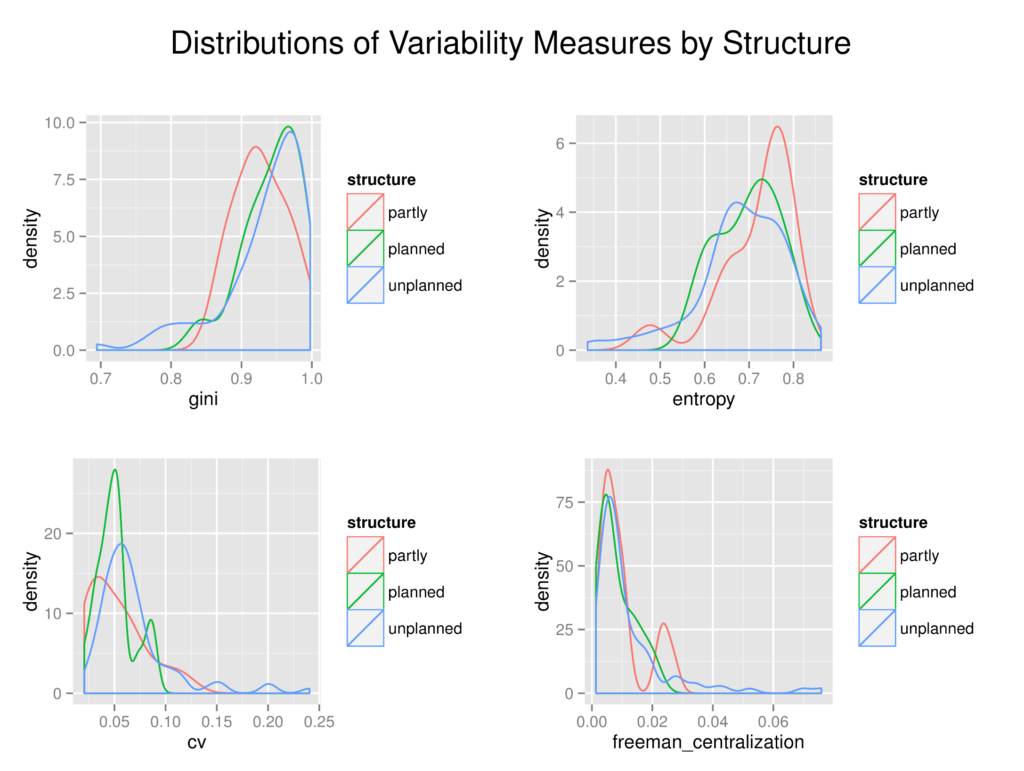

Slide 34
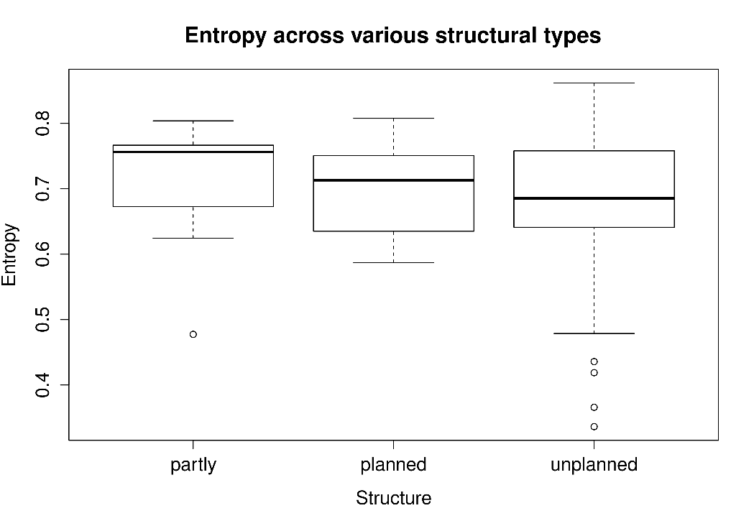
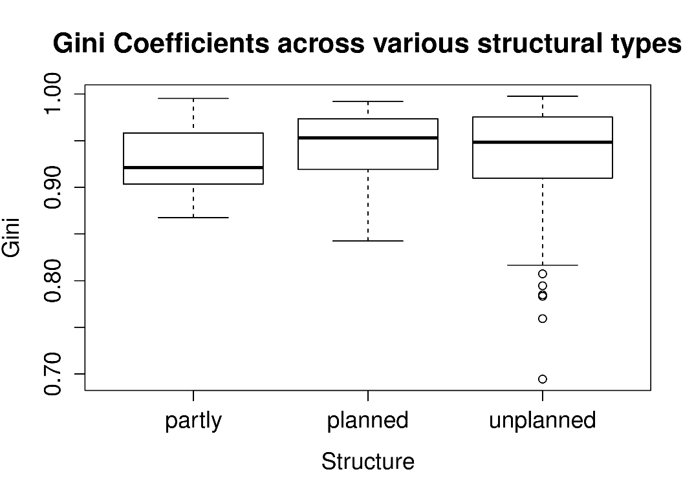
Structural Boxplots
Entropy
Gini Coefficient

Slide 35
Stats
 | df | H | P < 0.05
Entropy | 2 | 2.20 | False
Gini Coefficient | 2 | 2.07 | False

Slide 36
No significant Correlations
Area
Population

Slide 37
Contributions
Model
JIZNA
Applications

Slide 38
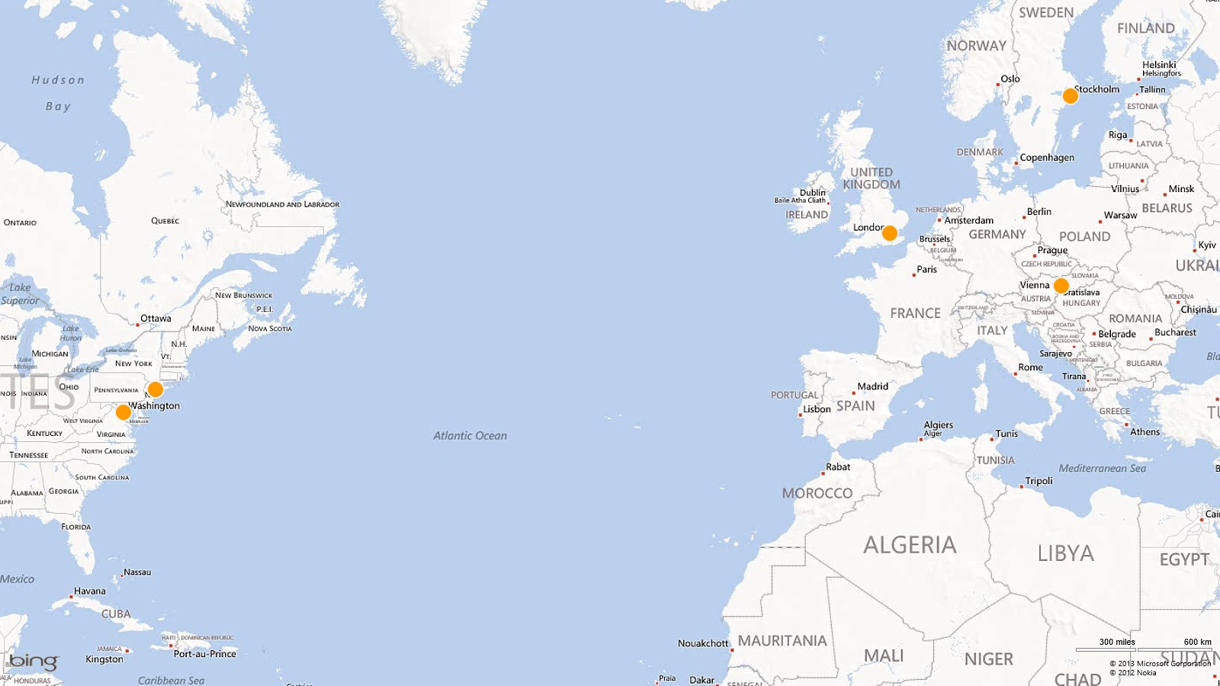
2012
Tag Challenge

Slide 39
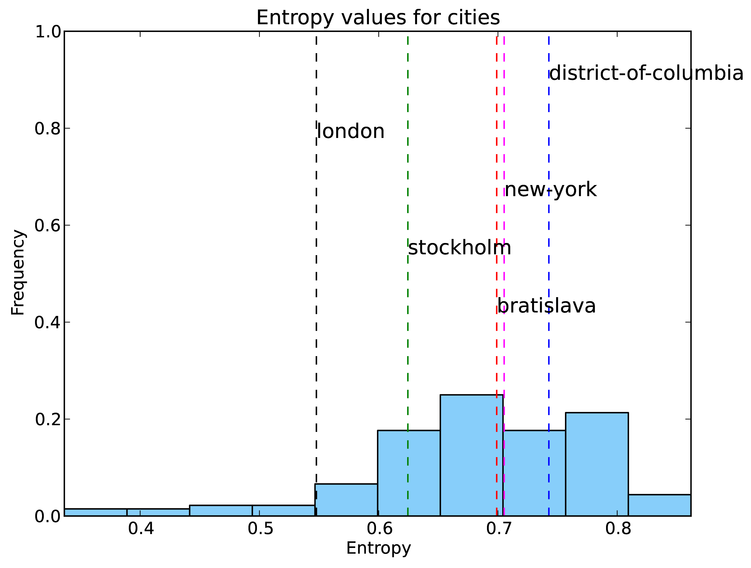
Tag Challenge Cities
Entropy

Slide 40
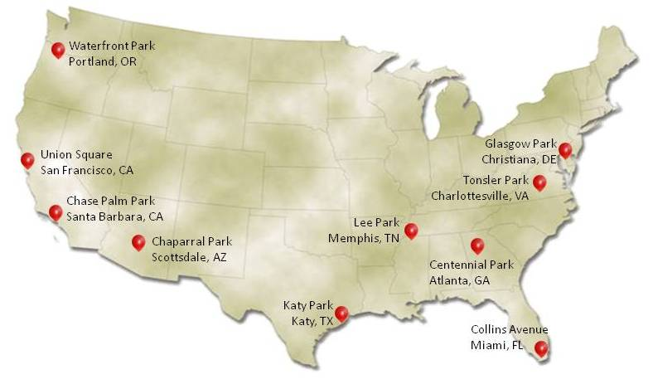
More to come
Data
Dynamic characteristics
DARPA’s Red Balloon Challenge

Slide 41
Finally…
Just about three major things
  The age of a city can influence the ease of search.
  City structure has no significant influence on ease of search.
  North American cities easier to search than European/Asian cities.

Slide 42
Thank you.

Slide 43
Questions

Slide 45
extras

Slide 46
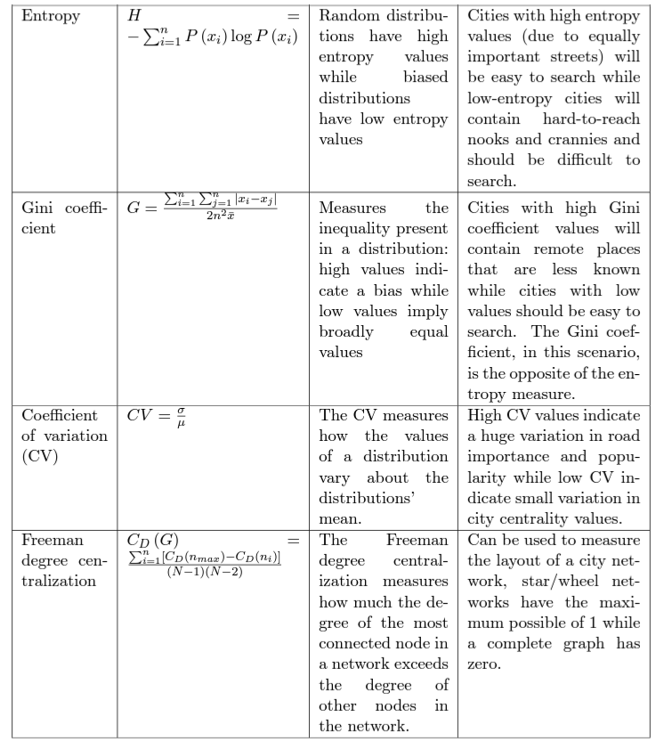

Slide 47


Projections

Slide 48




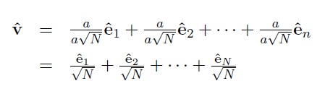
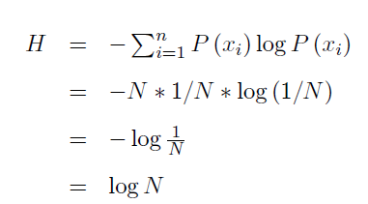
Normalization

